Slide 1
Contents
Magnetic Properties of Substances
Magnetic permeability
Magnetic susceptibility
Paramagnetic, Diamagnetic and Ferromagnetic substances
Theories of magnetism
Measurement of magnetic susceptibility
Application of magnetic susceptibility

Slide 2
Introduction
Magnetochemistry is concerned with the magnetic properties of chemical compounds.
It is one of the most powerful techniques to obtain information about the electronic structure, stereochemistry and the nature of metal-ligand bond.
Magnetic properties arise from the spin and orbital angular momentum of the electrons contained in a compound.

Slide 3
Introduction
William Gilbert was the first to investigate the phenomenon of magnetism systematically using scientific methods.
He also discovered that the Earth is itself a weak magnet.
Faraday showed that,
  Magnetic properties were not confined to a few elements like, Fe, Ni, Co etc.
  All substances and all form of matter possess magnetic properties of some degree
He divided all substances into three types:
  Diamagnetic substances
  Paramagnetic substances
  Ferromagnetic substances

Slide 4
Magnetic Permeability
The magnetic permeability is defined as the property of the material to allow the magnetic line of force to pass through it. It is denoted by µ.
The force F, acting between two magnetic dipoles of pole strength m₁ and m₂, separated by a distance r, is given by
F = m₁m₂/µr²
where, μ is a constant, characteristic of the medium and is called magnetic permeability.

Slide 5
Magnetic Permeability
Magnetic permeability (μ) of a medium represents the tendency of magnetic lines of force to pass through the medium relative to the tendency of the same lines of force to pass through air or vacuum.
Substances can be classified according to the value of μ. For vacuum μ = 1.
If μ < 1, substance is diamagnetic
  Diamagnetic substances are less permeable to the magnetic line of force than vacuum,
  The line of force prefer to pass through the vacuum rather than the substance

Slide 6
Magnetic Permeability
If μ > 1, substance is paramagnetic
  Paramagnetic substances are more permeable to the magnetic line of force than vacuum and
  The line of force prefer to pass through the substance rather than the vacuum
Substances having very higher value of μ (≈ 10³) are called ferromagnetic

Slide 7
Magnetic Substances
Some typical diamagnetic, paramagnetic and ferromagnetic substances.
Diamagnetic | Paramagnetic | Ferromagnetic
Antimony (s) | Aluminium (s) | Iron (s)
Carbon (s) | Magnesium (s) | Cobalt (s)
Ammonia (g) | Cupric chloride (s) | Nickel (s) and its alloys
Hydrogen (g) | Manganese sulphate (penta hydrate) (s)

Slide 8

Magnetic Susceptibility
The intensity of magnetisation (I) at any point in a body is directly proportional to the magnetic field (H), i.e.,
I H, or I = κH
where, κ is proportionality constant known as magnetic susceptibility of the medium.
As the intensity of magnetisation (I) is the magnetic moment per unit volume, κ is also known as volume susceptibility

Slide 9
Magnetic Susceptibility
Mass Susceptibility (χ):
It is the susceptibility per gram of the substance,
χ = κ/ρ
where, ρ is the density of the substance. χ is also known as specific susceptibility.
Molar Susceptibility (χ_{M}):
It is the susceptibility per mole of substance,
χ_{M} = χ.M
χ_{M} = κ/ρ M
where, M is the molar mass of the substance

Slide 10
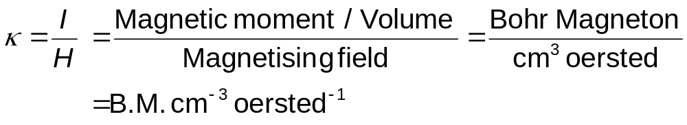
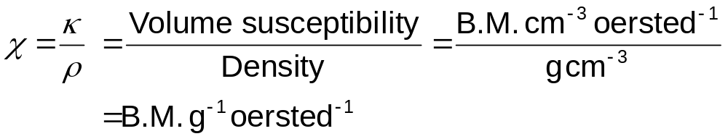
Units of Measurement
SI unit of Mass susceptibility is cm³ g⁻¹
SI unit of Molar susceptibility is cm³ mol⁻¹

Slide 11
Relation between Magnetic Lines of Force and Nature of Material
When a substance is placed in a magnetic field,
  The flux of magnetic lines of force in the material depends upon the nature of the material
  The magnetic lines of force would tend to avoid a diamagnetic material, and
  The material would tend to set itself at right angle to the direction of the field

Slide 12
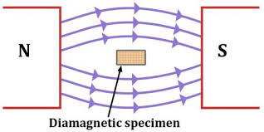

Relation between Magnetic Lines of Force and Nature of Material

Slide 13
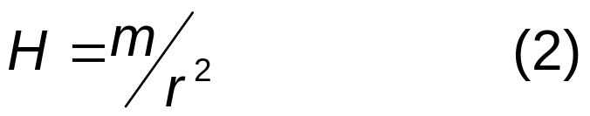
Relation between Magnetic Lines of Force and Nature of Material
Similarly,
  The magnetic lines of force would tend to pass through a paramagnetic material, and
  The material would tend to align itself
  in the direction of the field
The strength of the magnetic field (H)
  at any point in the field is defined as the force experienced by a unit magnetic pole at that point. If the medium is air/vacuum,
  Unit is Oersted or Gauss or Tesla (SI unit)

Slide 14
Relation between Magnetic Permeability and Mass Susceptibility
If a material of permeability μ, is placed between the unit pole and the magnet, the intensity of magnetic field in the material is called magnetic induction (B), which is expressed as
  B = μH (3)
  If the intensity of magnetisation induced by the field in the medium is I, then
  B = H + 4πI
  Using, B = μH, one gets
  μH = H + 4πI
  or μ = 1 + 4π(I/H) (4)

Slide 15
Relation between Magnetic Permeability and Mass Susceptibility
  As volume susceptibility, κ = I/H, eqn. (4) gives
  μ = 1 + 4πκ (5)
  From eqn. (5), we see,
    κ is –ve for diamagnetic substances
    κ is +ve for paramagnetic substances
    κ is very large for ferromagnetic substances
  When existing magnetic field is removed,
    Magnetisation of diamagnetics and paramagnetics disappears
    Ferromagetics exhibit residual or permanent magnetisation

Slide 16
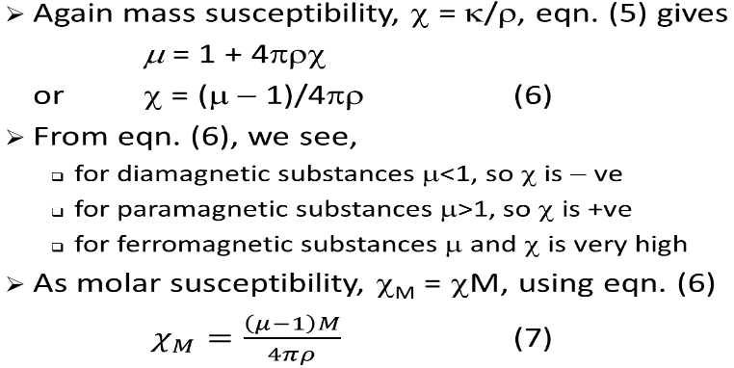
Relation between Magnetic Permeability and Mass Susceptibility

Slide 17
Types of Substances
According to the behaviour in magnetic field all substances are divided into three types:
1) Diamagnetic substances
2) Paramagnetic substances
3) Ferromagnetic substances

Slide 18
Types of Substances
  Diamagnetic substances: These substances are repelled by the magnets and when placed in a magnetic field move from stronger to weaker parts of the field.
    Examples are, bismuth, antimony, copper, water, alcohol, and hydrogen, etc.
  Characteristics:
    In a magnetic field the lines of force tend to move away from the material (permeability μ<1)
    Magnetic susceptibility values are small −ve
    Magnetic susceptibility values do not change with temperature

Slide 19
Types of Substances
  Paramagnetic substances: These substances are attracted by magnets and when placed in a magnetic field move from weaker to stronger parts of the field.
    Examples are, aluminium, manganese, oxygen, platinum, etc.
  Characteristics:
    In a magnetic field the lines of force tend to accumulate in the material (permeability μ>1)
    Magnetic susceptibility values are small +ve
    Magnetic susceptibility values are inversely proportional to the absolute temperature

Slide 20
Types of Substances
  Ferromagnetic substances: These are substances which are attracted by the magnets and can also be magnetised.
    Examples are, Fe, Co, Ni, most of their alloys, etc.
  Characteristics:
    Show all the properties of paramagnetic substances to a much greater degree
    Magnetic susceptibility has a +ve value and the permeability is very high
    Susceptibility decreases as the temperature increases

Slide 21
Curie’s Law
In 1895, Pierre Curie measured the susceptibility of a large number of diamagnetic and paramagnetic substances at different temperatures. Results are summarized in two laws:
  The diamagnetic susceptibility is independent of temperature.
  The paramagnetic susceptibility is inversely proportional to the absolute temperature.
  κ 1/T
  where, κ = magnetic susceptibility, T = absolute temperature

Slide 22
Curie-Weiss law
As temperature increases the values of susceptibility drops suddenly at a particular temperature, known as Curie point or critical temperature and the substance becomes paramagnetic
Curie point for cobalt is 1100ºC and nickel is 400ºC
Above Curie point, the susceptibility of ferromagnetic substance is proportional to the difference of temperatures between the material and Curie point, known as
Curie-Weiss law

Slide 23
Theory of Diamagnetism
  In 1905 Paul Langevin proposed a mathematical theory for both dia- and paramagnetism applying the electronic theory of matter.
  Langevin theory of diamagnetism is based on the following ideas:
  The atom of a diamagnetic substance is such that the resultant magnetic moment of the atom as a whole is zero.
  When an external field is applied to such an atom, there occurs a uniform precession of electron orbits.
  The precession does not alter the position of the system but simply displaces the position of electron orbits relative to each other
  So that atom as a whole possesses a negative magnetic moment but not zero.

Slide 24
Theory of Diamagnetism
Let us consider an electron of charge e and mass m moving in a circular orbit of radius r with u and ω the linear and angular velocities respectively.
The revolving electron is kept in a circular orbit by the force of attraction F due to the central positive nucleus balanced against the centrifugal force. This yields
F = mu²/r = mω²r (as u = rω) (1)

Slide 25
Theory of Diamagnetism
H
If a magnetic field H is now
applied perpendicular to the
plane of the orbit of this single electron,
then an additional force F₁ or Heu or Herω will act on the electron at right angles to both the orbit and the magnetic field.
According to the Lenz’s law the direction of this force is opposite to that of the centrifugal force.
Therefore the net force F’ on the electron in the magnetic field is
F’ = F +(- F₁)= mω²r - Herω (2)
e
ω
r

Slide 26
Theory of Diamagnetism
The effect of this force changes the angular velocity of the electron without changing the radius of the orbit.
Suppose the new angular velocity is ω + Δω. Then the net force F’ is given by
F’ = m(ω + Δω)²r = m(ω² + 2ωΔω + Δω²) (3)
  = m(ω² + 2ωΔω)r (as is Δω² negligible)
  From equation (2) and (3), we get
  mω²r – Herω = m(ω² + 2ωΔω)r
  Or Δω = - He/2m (3A)
  The negative sign indicates that the change in angular velocity acts in a sense opposite to that of the electron

Slide 27
Theory of Diamagnetism
The change in angular velocity dw gives rise to change in magnetic moment which may be derived as follows:
A charge e revolving in a circle at the rate of n revolutions per second is equivalent to ne.
Suppose ‘a’ is the area of the circle
The change in magnetic moment,
Δµ, due to a change Δω in angular
velocity is given by
Δµ = e.a.Δn = e.a.Δ(ω/2π) = (e.a/2π)Δω
  = e(πr²)xΔω/2π (4)
Substituting eq. (3A) in eq. (4), we get
H
e
ω
r

Slide 28
Theory of Diamagnetism
Δµ = -eπr²He/2(2πm) = -Hr²e²/4m (5)
If the electronic orbit is not perpendicular to the applied field the r is replaced by r₁. Therefore, eq.(5) becomes
Δµ = -Hr₁²e²/4m (6)
If an atom of atomic number Z is considered, there are Z electronic orbits and these orbits may lie in all the possible directions in space. Therefore, the total induced magnetic moment is given by
∑Δµ = ∑(-HZr₁²e²/4m) = -HZe²/4m ∑r₁² (7)

Slide 29
Theory of Diamagnetism
  If x, y and z are the spherical polar co-ordinates of the radius r of an orbit,
  r² = x² + y² + z² (8)
  If z-axis is selected in the plane perpendicular to the applied field,
  r₁² = x² + y² (9)
  For a spherically symmetrical atom,
  x² = y² = z² (10)
  Then eq. (8) becomes
  r² = x² + x² + x² = 3x² (11)
  and r₁² = x² + x² = 2x² = 2/3r² (12)
  Substituting the value of r₁² in eq. (7)
  ∑Δµ = -HZe²/4m ∑2/3r² = -HZe²/6m ∑r² (13)

Slide 30
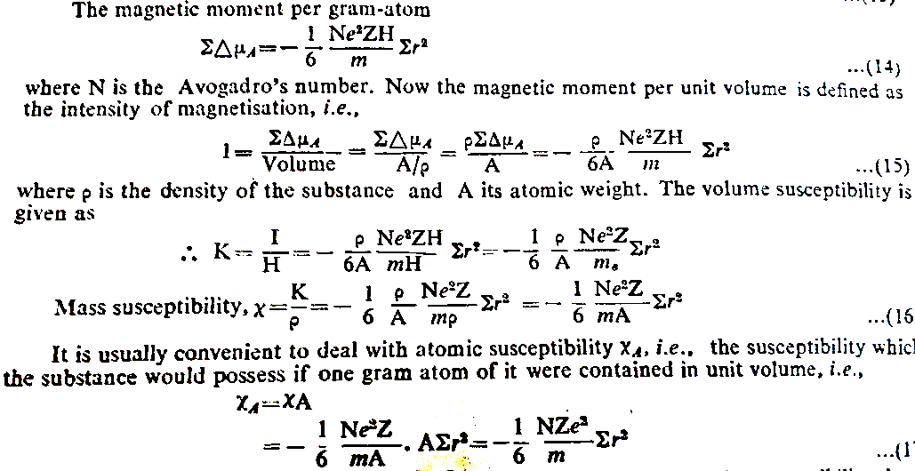

Slide 31
Theory of Diamagnetism
  Some important conclusion from above eqn.,
  Diamagnetism is a universal property of matter, is independent of temperature and field strength.
  Since each one of the electron orbit in an atom would acquire an induced moment opposed to the direction of the applied field, the moment of the atom as whole would also be modified. This means that even in the case of para- and ferromagnetic bodies, the diamagnetism is present.
  The negative sign shows not only that this quantity has a negative value, but also that diamagnetism is an induced opposing effect, that disappears as soon as the field is removed. (Δμ = 0 when H = 0)

Slide 32
Theory of Paramagnetism
Langevin assumed that the molecules of the paramagnetic gas have small permanent magnets due to rotating electrons. When a magnetic field is applied, the molecules will tend to orient themselves with their magnetic axes in the direction of the field. This tendency will, however, be opposed by the collisions due to thermal motion between the molecules. As a result, there will be an equilibrium distribution of the axes with reference to the direction of the field, which can be calculated by using the kinetic theory of gases.

Slide 33
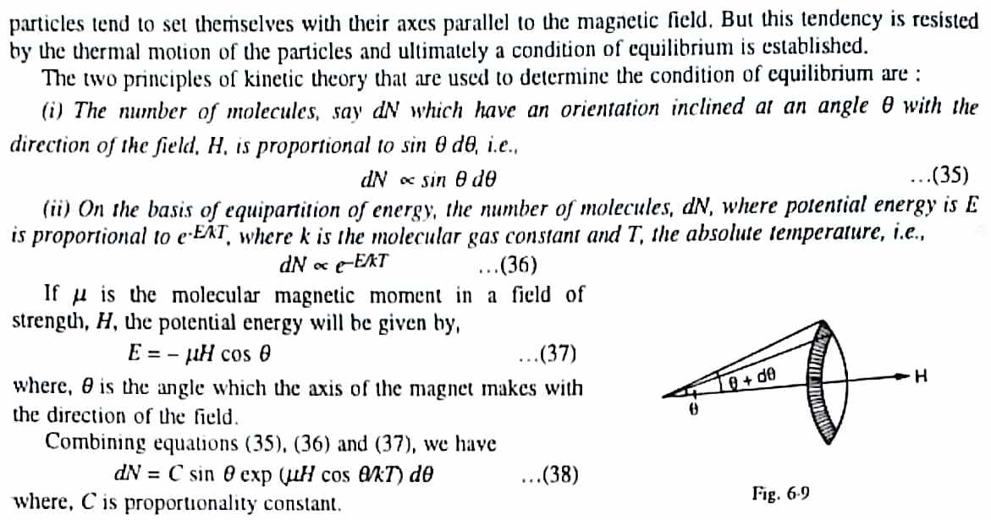
Theory of Paramagnetism

Slide 34
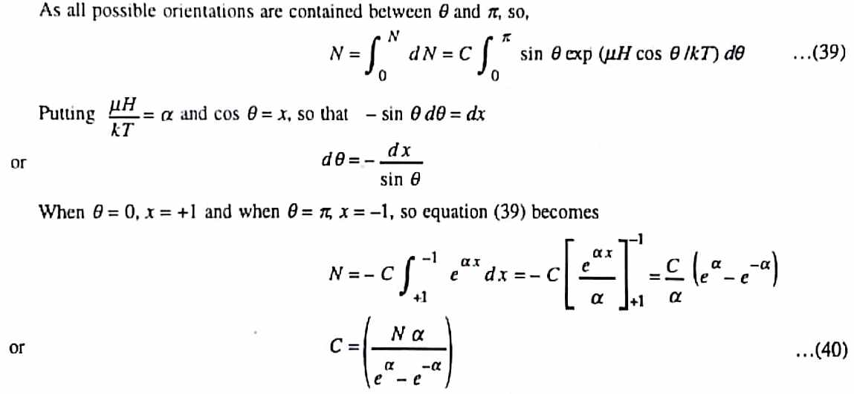
Theory of Paramagnetism
π
π

Slide 35
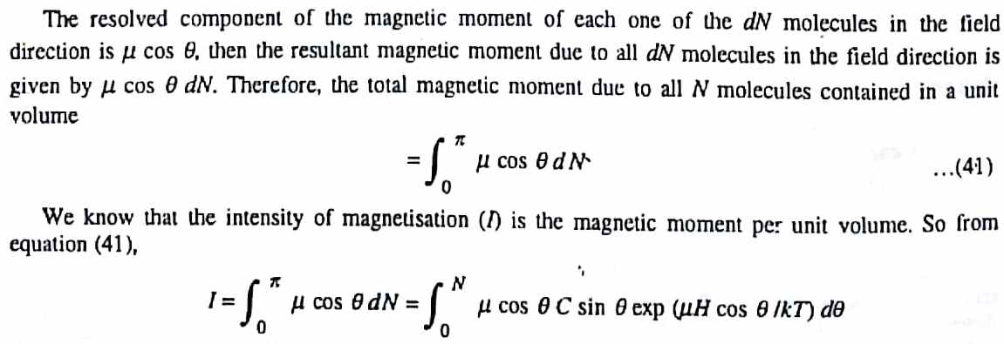
Theory of Paramagnetism

Slide 36
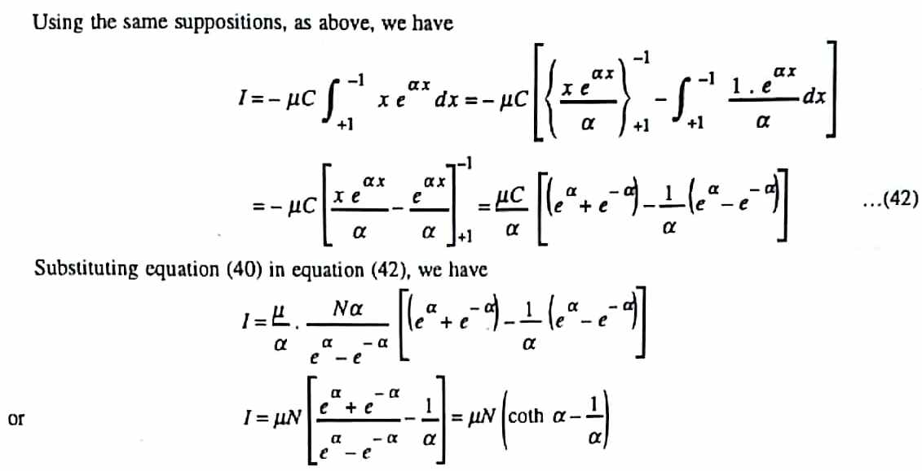
Theory of Paramagnetism

Slide 37
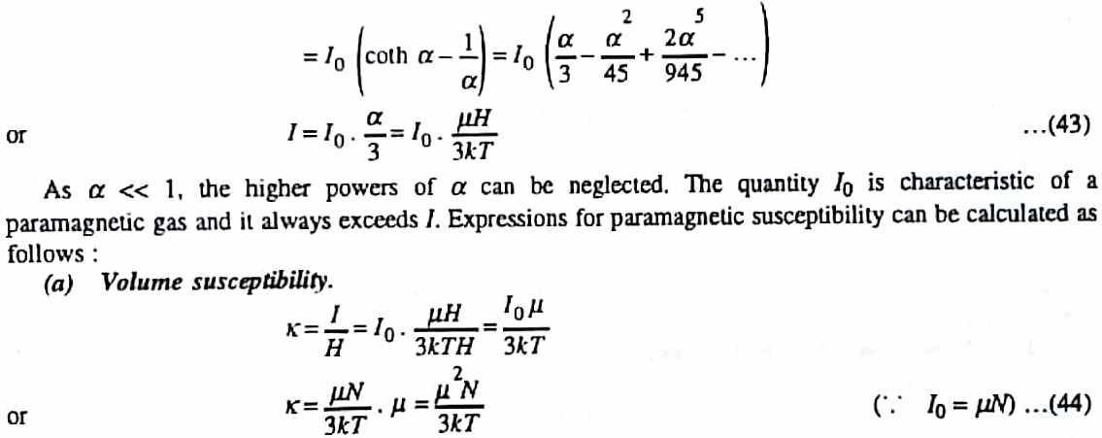
Theory of Paramagnetism

Slide 38
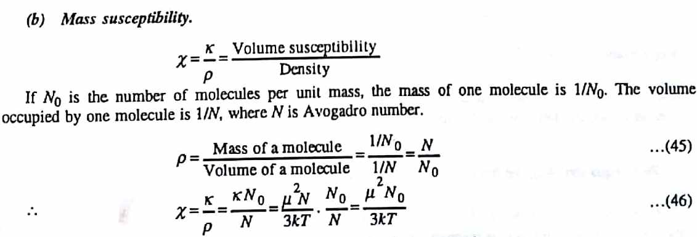
Theory of Paramagnetism

Slide 39
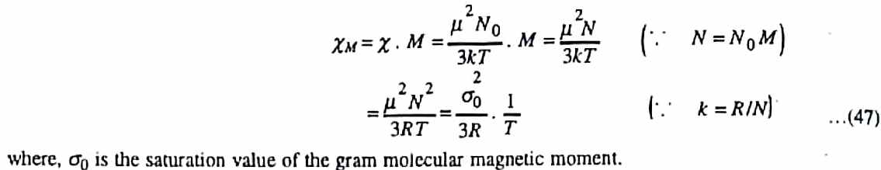
Theory of Paramagnetism

Slide 40
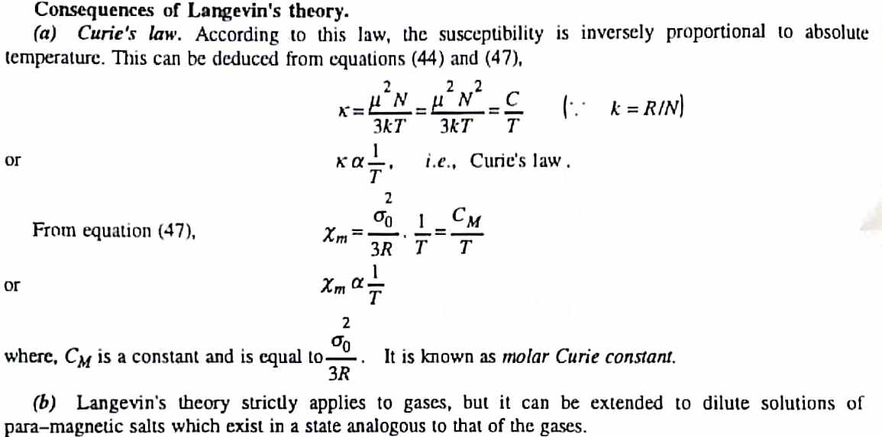
Theory of Paramagnetism

Slide 41
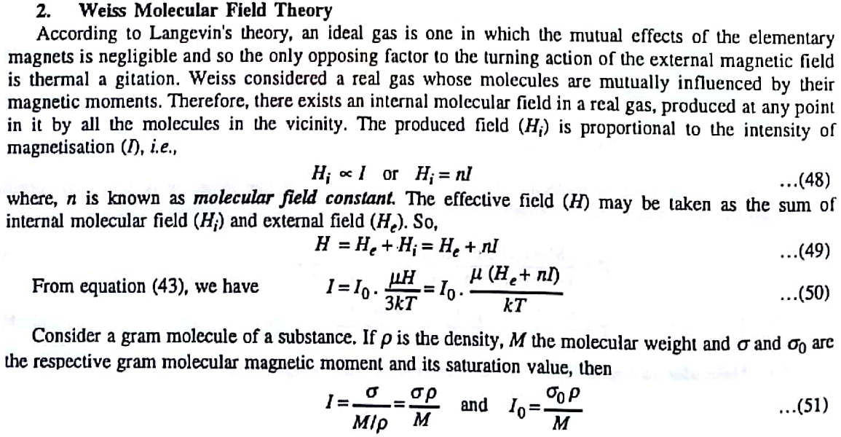
Theory of Paramagnetism

Slide 42
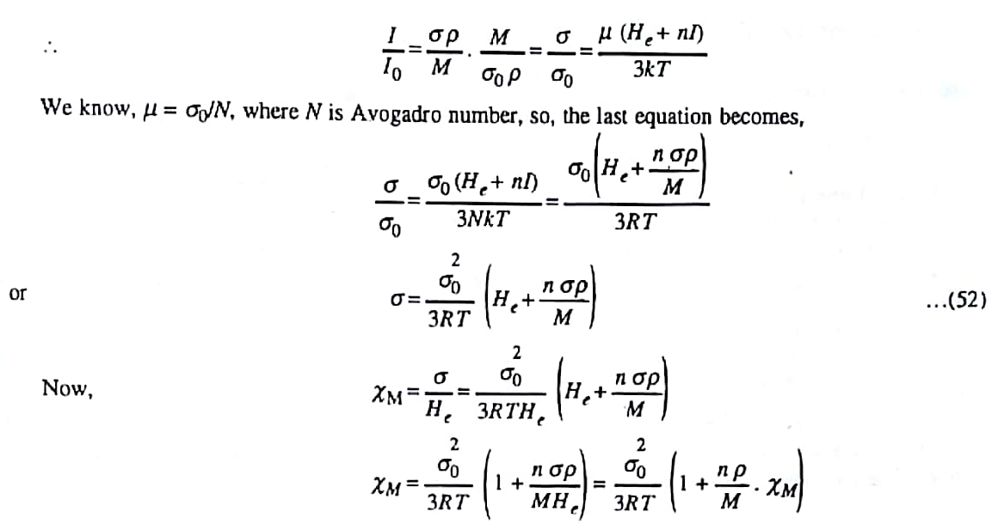
Theory of Paramagnetism

Slide 43
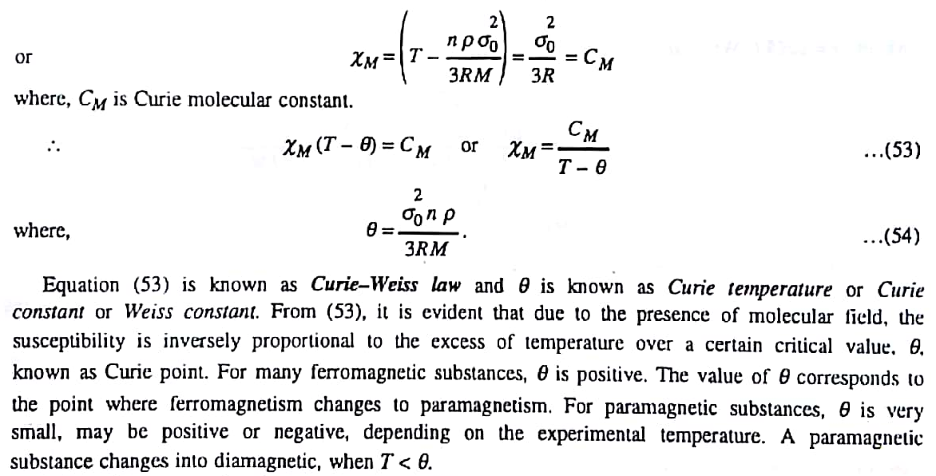
Theory of Paramagnetism

Slide 44
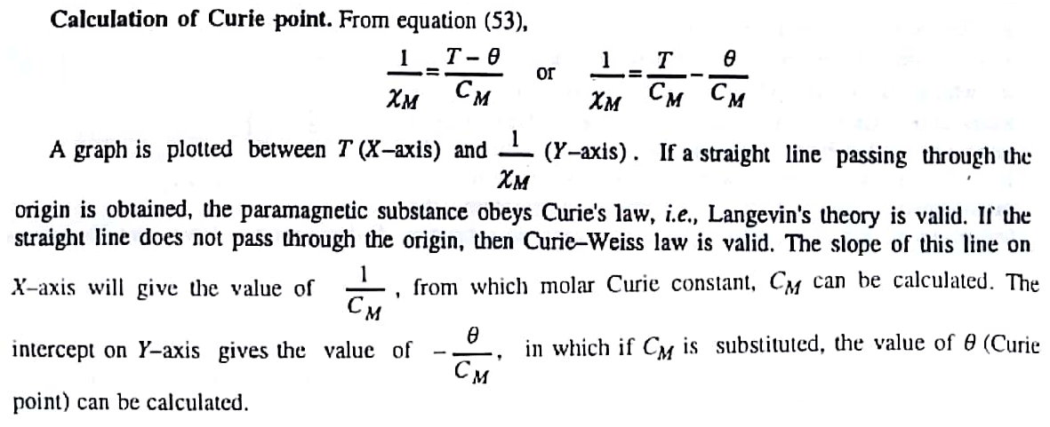
Theory of Paramagnetism

Slide 45
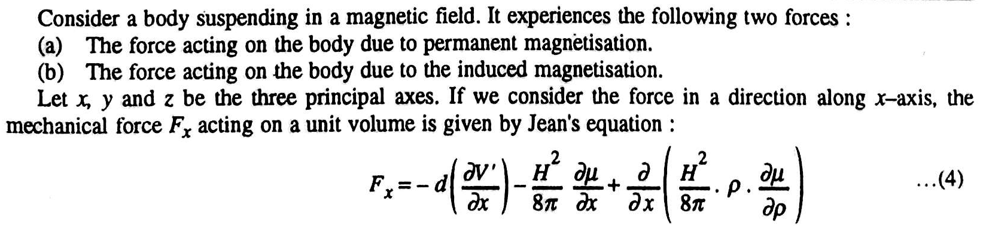
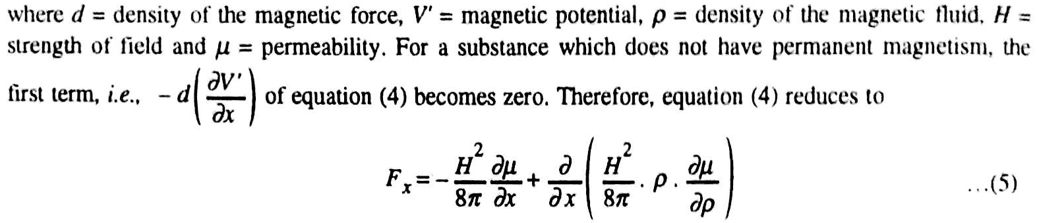
Measurement of Magnetic Susceptibilities
Forces Acting on a Body in a Magnetic Field

Slide 46
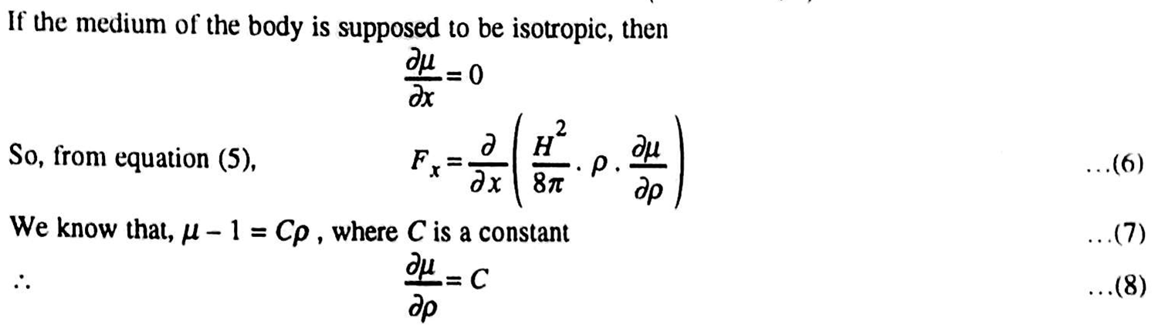
Forces Acting on a Body in a Magnetic Field

Slide 47
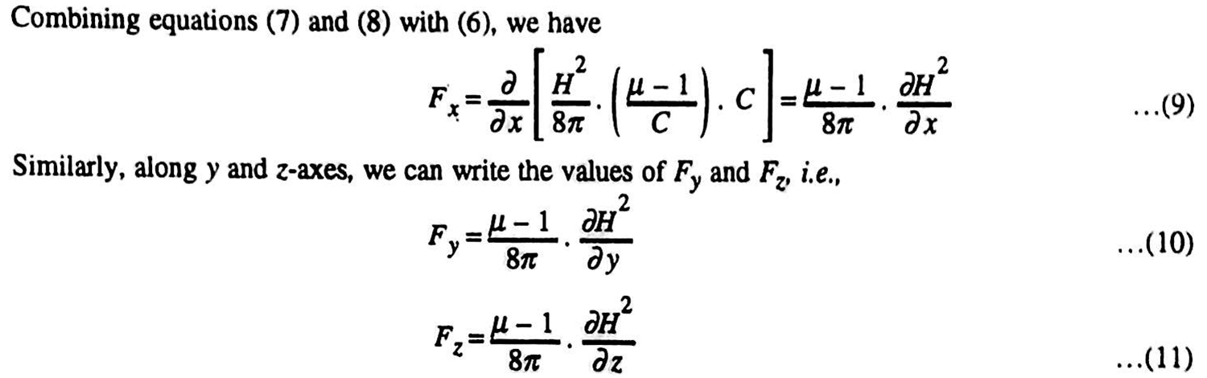
Forces Acting on a Body in a Magnetic Field

Slide 48
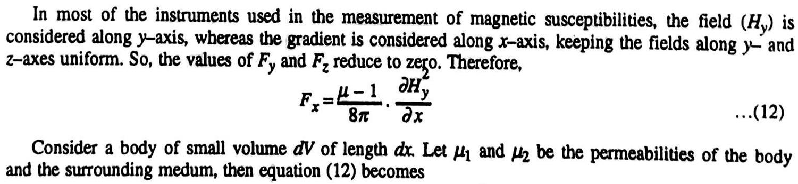
Forces Acting on a Body in a Magnetic Field

Slide 49
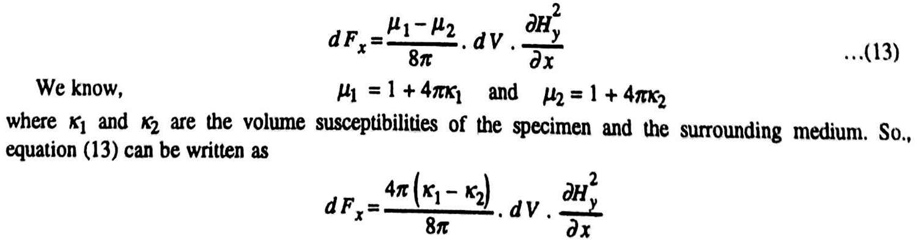
Forces Acting on a Body in a Magnetic Field

Slide 50
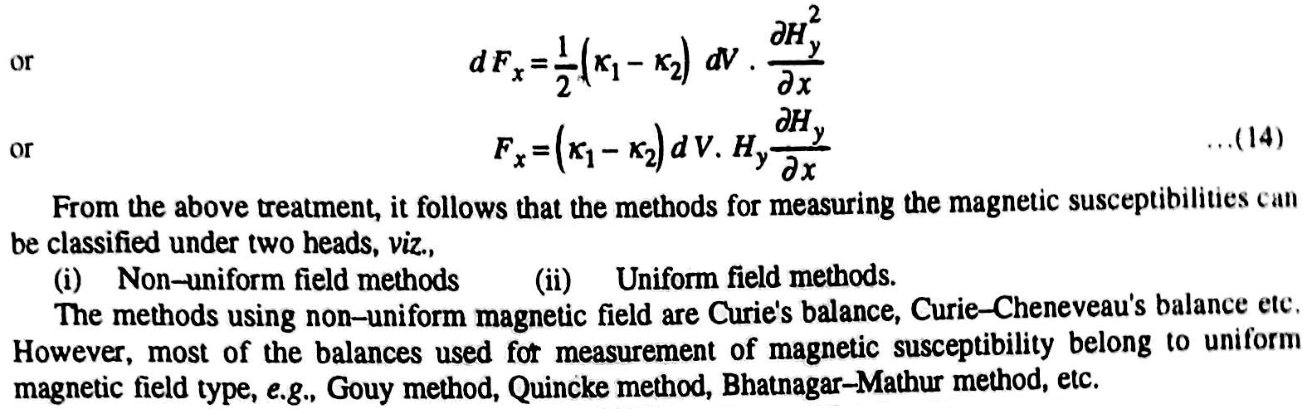
Forces Acting on a Body in a Magnetic Field
d

Slide 51
Measurement of Magnetic Susceptibilities
Experimental methods
  Experimental methods for the determination of magnetic susceptibilities can be classified into two heads:
Uniform field method
Non-uniform field method
Gouy method
Quincke method
Bhatnagar-Mathur method
Curie’s balance
Curie-Cheneveau’s balance
Most common methods belong to uniform magnetic field type
Gouy method is preferable if 10 g substance is available
Curie method is recommended for even smaller amount of substance and also for measurements at higher temperatures

Slide 52
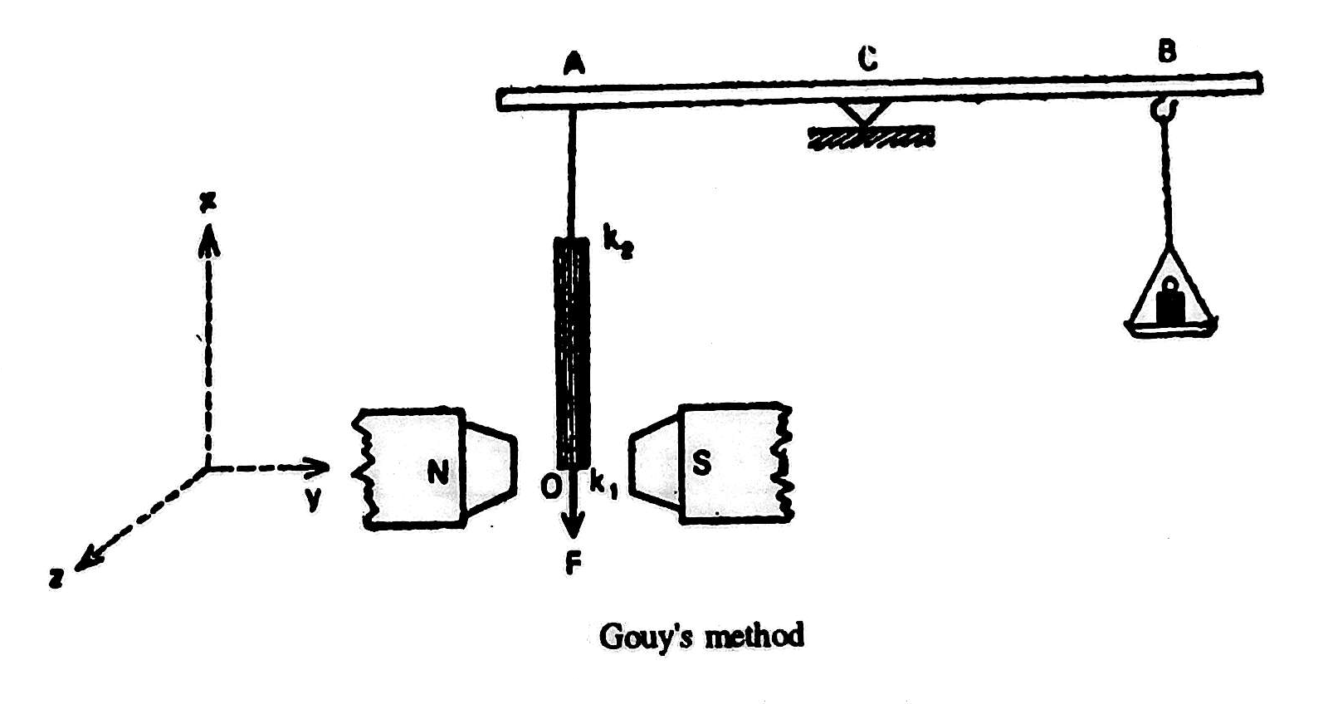
Measurement of Magnetic Susceptibilities
Gouy´s Homogeneous Field Method (1889)

Slide 53
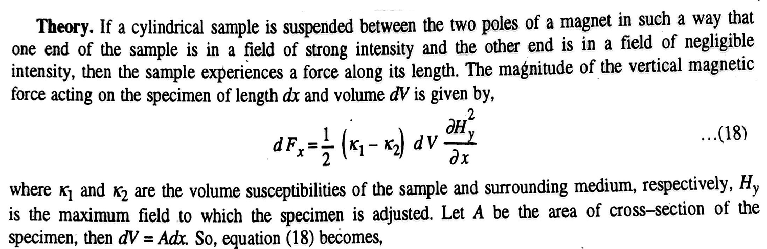
Gouy’s Homogeneous Field Method

Slide 54
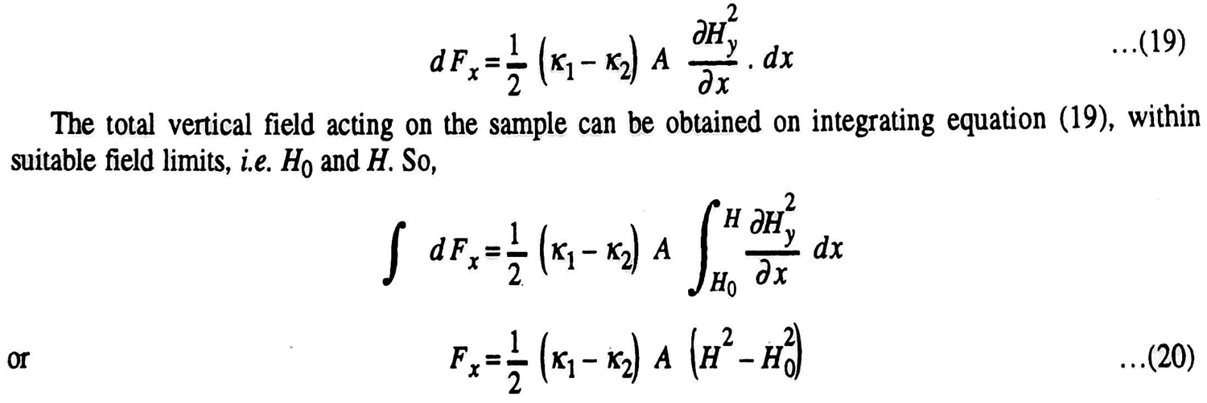
Gouy’s Homogeneous Field Method

Slide 55
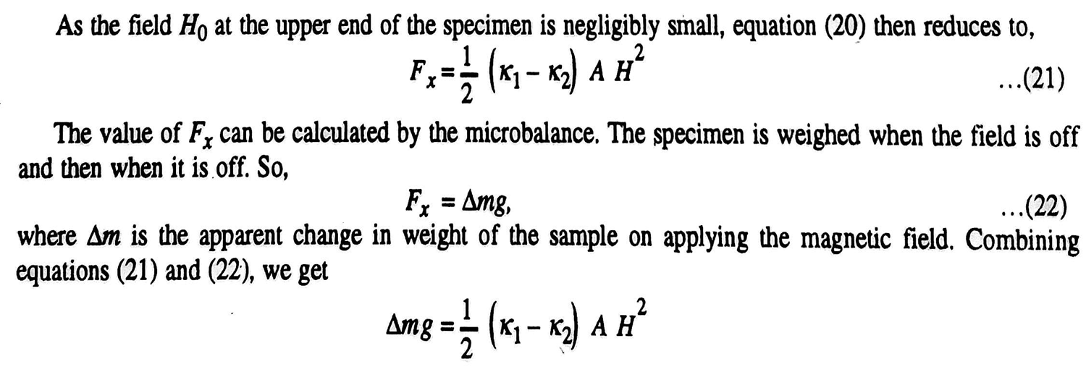
Gouy’s Homogeneous Field Method
on. So

Slide 56
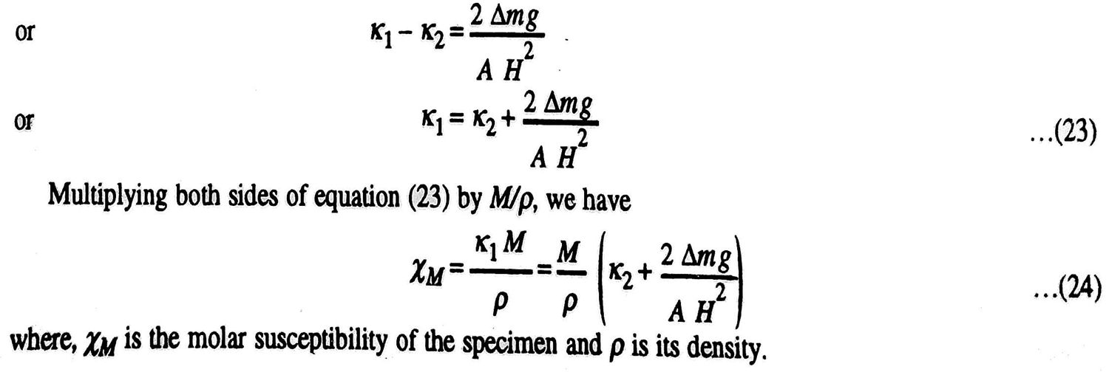
Gouy’s Homogeneous Field Method

Slide 57
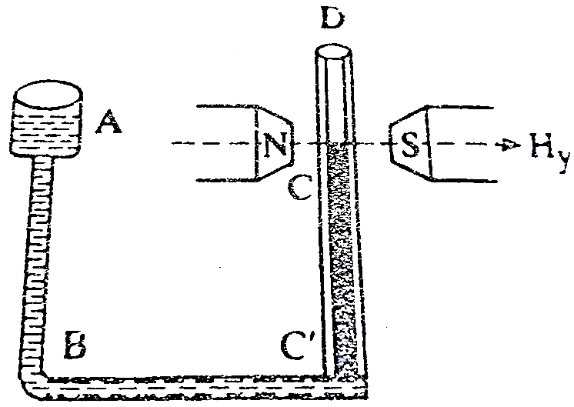
Quincke’s Method
This method is suitable for liquid, aqueous solution and gases.
C’D is the capillary tube, which is placed in a uniform magnetic field of strength 25000 oersted. AC’ is the wider tube. The field strength near the wider end (end C’) is 50-100 oersted.

Slide 58
Quincke’s Method
If current is switched on, a strong and uniform magnetic field is established at the upper surface of the capillary tube whereas lower surface experience a weak filed.
If the liquid is paramagnetic, the meniscus will rise whereas a fall will be observed if the liquid is diamagnetic.
Suppose Δh is the change in the height of the meniscus. Then, the corresponding hydrostatic pressure will be given by
P = ρ.g.Δh

Slide 59
Quincke’s Method
Therefore
force = P.A
where A is the area of cross-section of the tube. This equation represents the vertical force, F_{x} i.e.,
F_{x} = ρ.g.Δh.A
The vertical force due to change in the hydrostatic pressure will be balanced by meniscus pull given by the equation
F_{x} = ½(K₁ – K₂)AH²
Therefore,
ρgΔh.A = ½(K₁-K₂)AH²
or, K₁ – K₂ = 2ρgΔh/H²

Slide 60
Quincke’s Method
or, K₁/ρ – K₂/ρ = 2gΔh/H²
or K₁/ρ – (K₂/ρ⁰)xρ⁰/ρ = 2gΔh/H²
or, χ – χ₀xρ⁰/ρ = 2gΔh/H²
χ and χ ₀ are the mass susceptibilities of the liquid (density = ρ) and vapour (density = ρ⁰) respectively.
If the tube AB is of sufficient large diameter and the susceptibility of the vapour above the liquid meniscus is negligible then equation can be written as
χ = 2gΔh/H²

Slide 61
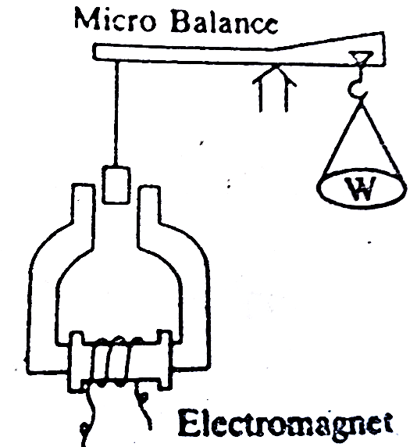
Measurement of Magnetic Susceptibilities
Curie´s Magnetic Balance (1895)
The Curie balance using an eletromagnet which is shown in the following figure

Slide 62
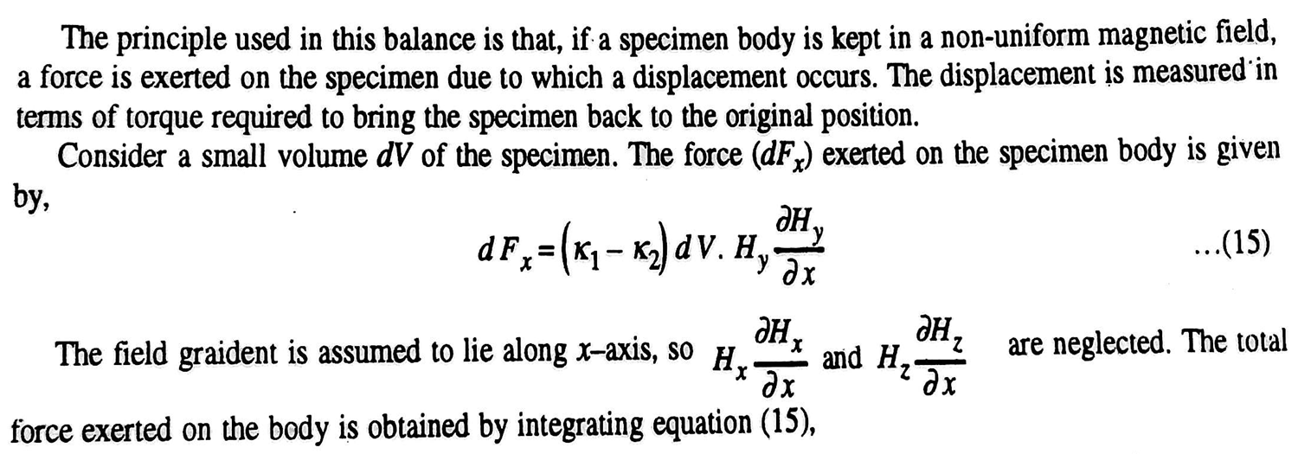
Curie’s Magnetic Balance

Slide 63
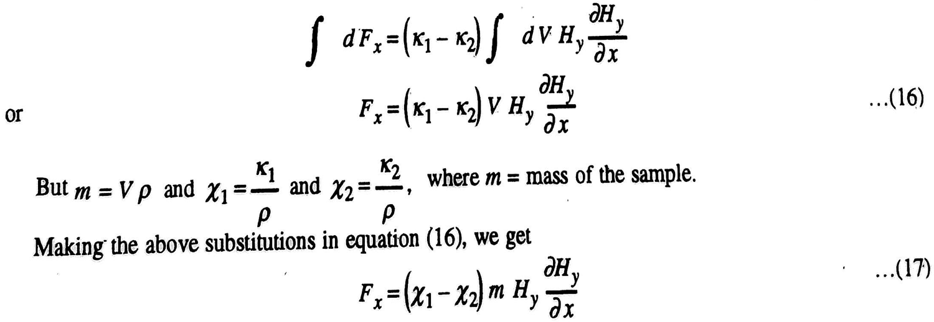
Curie’s Magnetic Balance

Slide 64
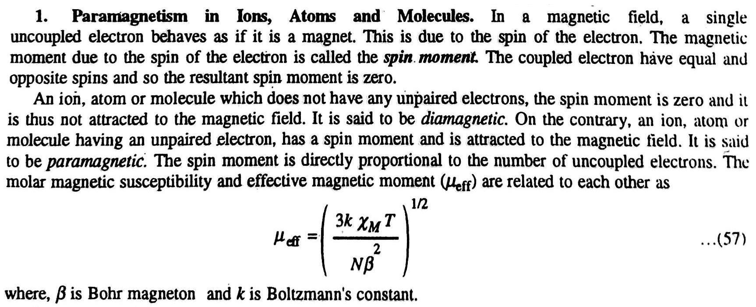
Application of Magnetic Susceptibilities

Slide 65
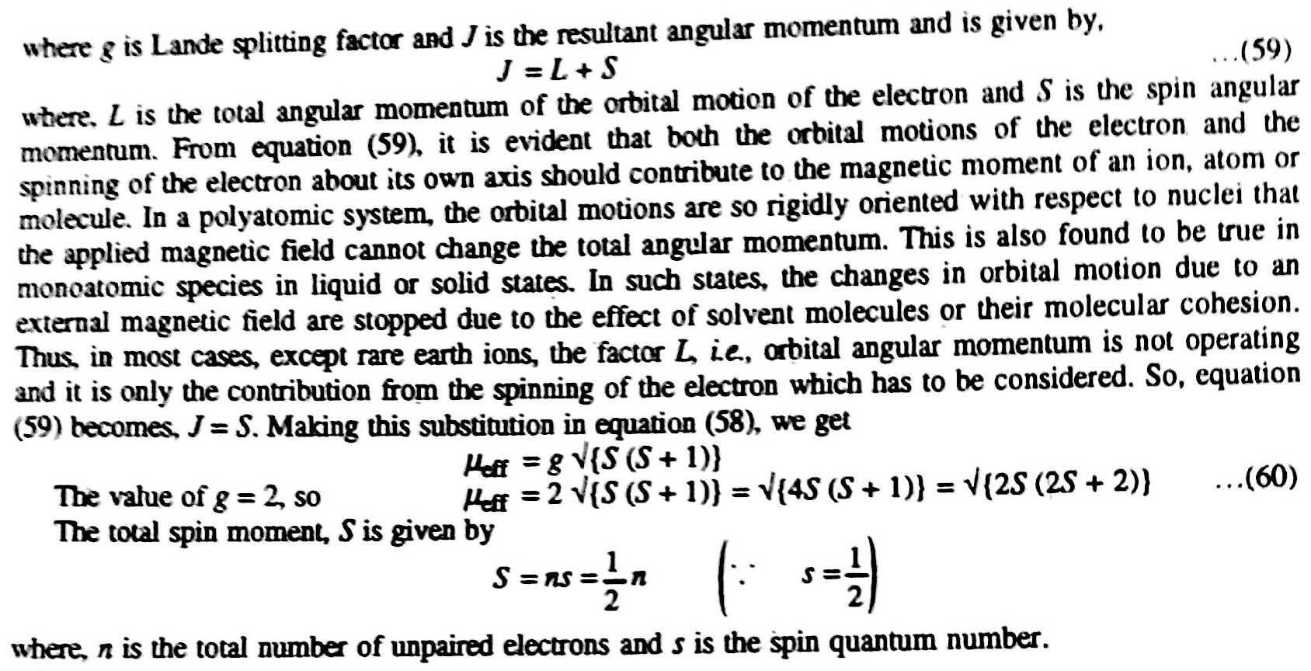
Application of Magnetic Susceptibilities

Slide 66
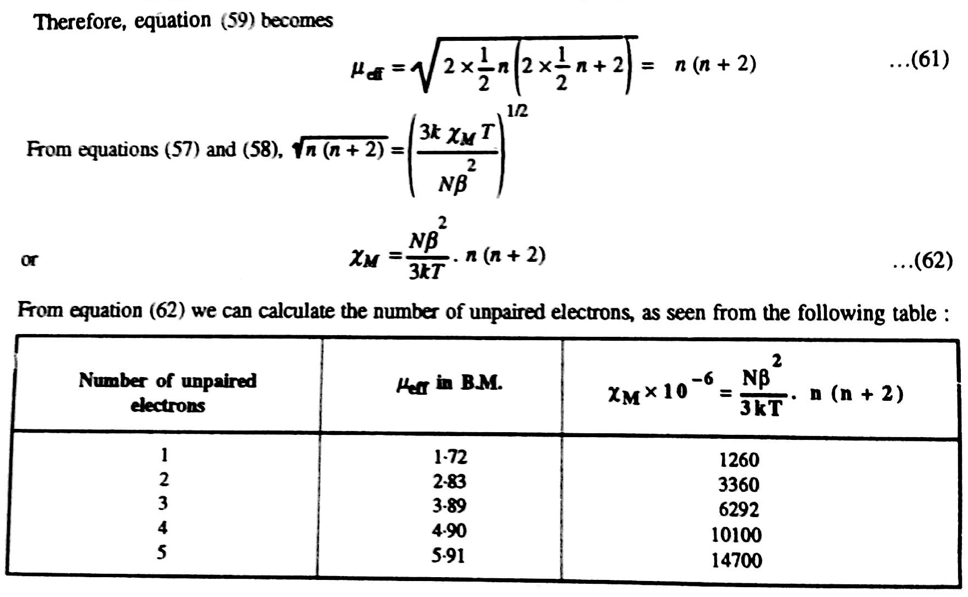
Application of Magnetic Susceptibilities

Slide 67
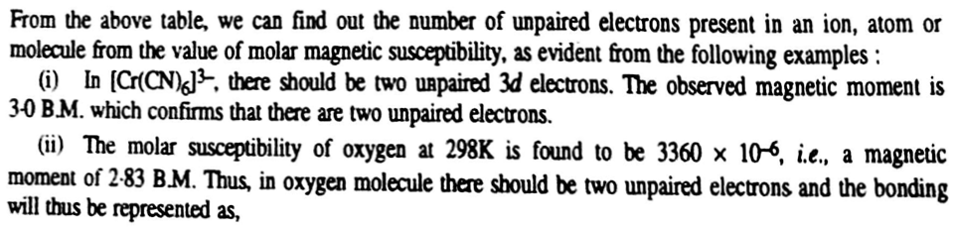
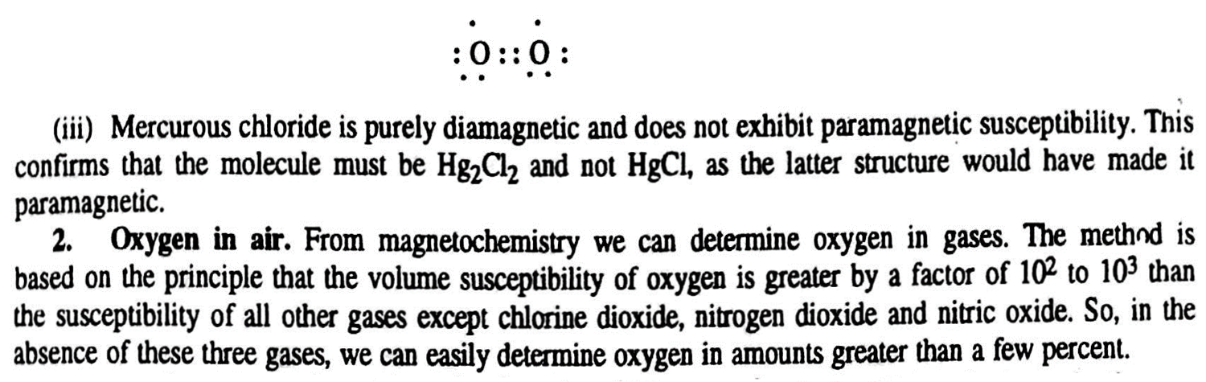
Application of Magnetic Susceptibilities

Slide 68
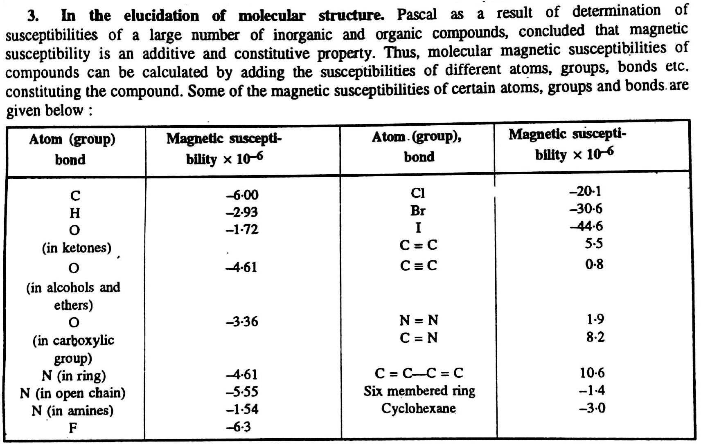
Application of Magnetic Susceptibilities

Slide 69
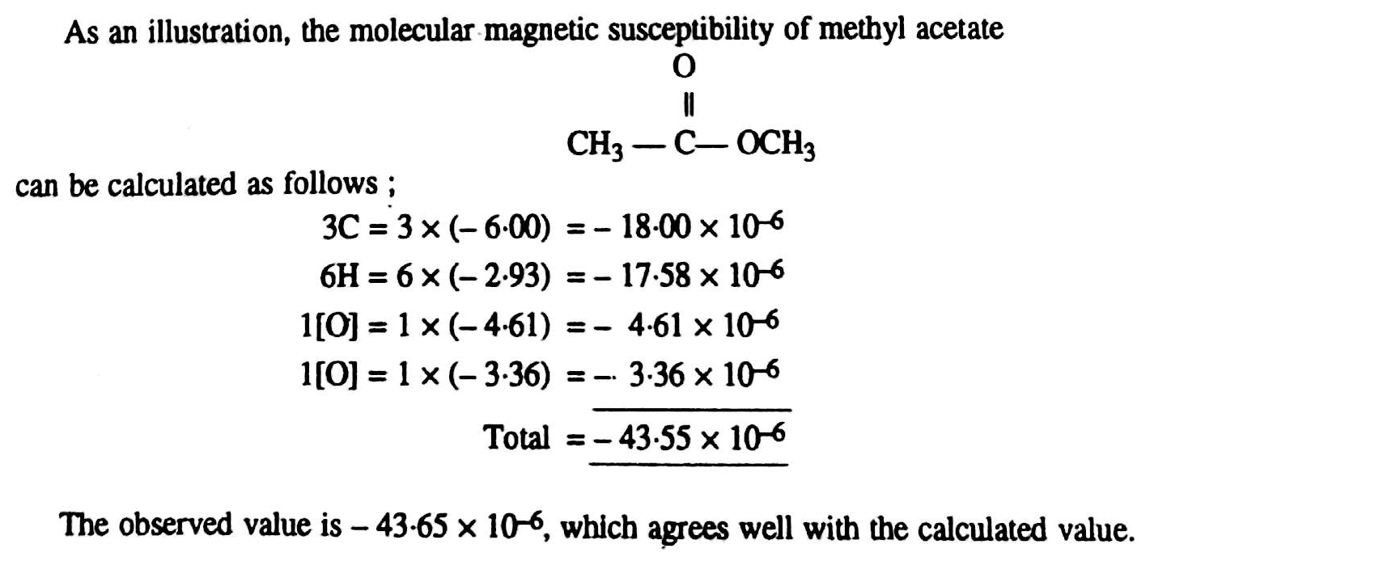
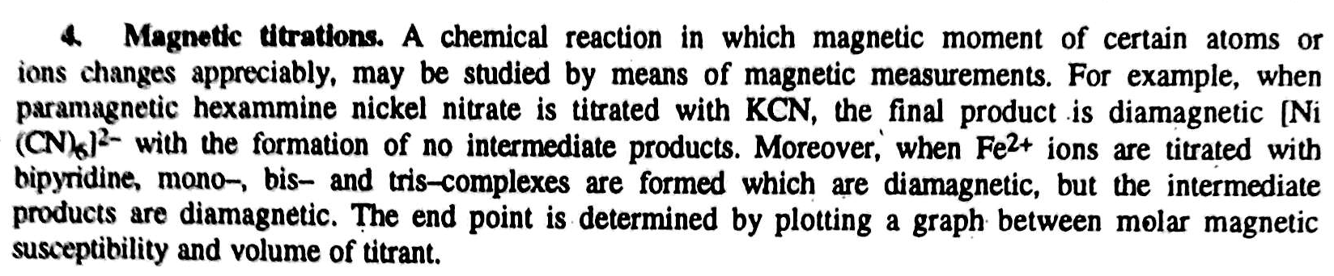
Application of Magnetic Susceptibilities

Slide 70
Prob. 1: The molar magnetic susceptibility of H₂O (l) at 25⁰C is -13x10⁻¹² m³ mol⁻¹, while density is 0.997 g cm⁻³. Find (a) the mass susceptibility, and (b) the magnetic permeability of H₂O (l) at this temperature.
We know, χ_{M} = χM or, χ = χ_{M}/M = = -13x10⁻⁶/18 = -0.722x10⁻⁶ cm³ g⁻¹ (b) Again, χ = (µ-1)/4πρ or, µ - 1 = 4πρχ or, µ - 1 = 4x3.14x0.997x(-0.722x10⁻⁶) = -9.041x10⁻⁶ = 1 - 9.041x10⁻⁶ = 0.9999 | Here, χ_{M} = -13x10⁻¹² m³ mol⁻¹ = -13x10⁻⁶ cm³ mol⁻¹ M = 18 ρ = 0.997 g cm⁻³ χ = ?

Slide 71
Prob. 2: The molar magnetic susceptibility of a molecule is 3360x10⁻⁶ cm³ mol⁻¹ at 25⁰C. Calculate the number of unpaired electrons in that molecules. µ_{B}= 9.273x10⁻²¹g cm⁻³.
We know, n(n+2) = 3kTχ_{M}/Nµ_{B}² = 3x1.38x10⁻¹⁶x298x 3360x10⁻⁶/ 6.023x10²³x(9.273x10⁻²¹)² = 8 or, n² + 2n = 8 or, n² + 2n – 8 = 0 or, n² + 4n - 2n – 8 = 0 or, n(n+4) -2(n+4) = 0 or, (n+4)(n-2) = 0 or, n = 2 | Here, χ_{M} = 3360x10⁻⁶ cm³ mol⁻¹ T = 298 µ_{B} = 9.273x10⁻²¹ g cm⁻³ N = 6.023x10²³ k = 1.38x10⁻¹⁶

Slide 72
Prob. 3: The magnetic moment of a molecule is 2.66x10⁻²⁰ emu at 25⁰C. Calculate the molar magnetic susceptibility of that molecule.
We know, χ_{M} = Nµ²/(3kT) = 6.023x10²³x(2.66x10⁻²⁰)²/ 3x1.38x10⁻¹⁶x298 = 3450x10⁻⁶ cm³ mol⁻¹ | Here, χ_{M} = ? T = 298 µ = 2.66x10⁻²⁰ N = 6.023x10²³ k = 1.38x10⁻¹⁶

